Slide 1
Digital Forensics Lecture-6
By- Dr.subhranil Das
Assistant Professor
School of computer Science

Slide 2

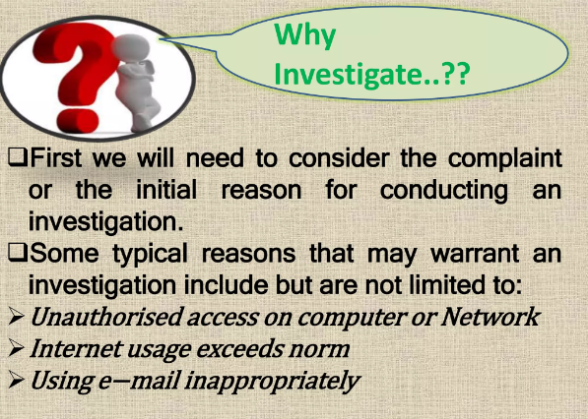
Why digital analysis is required?

Slide 3
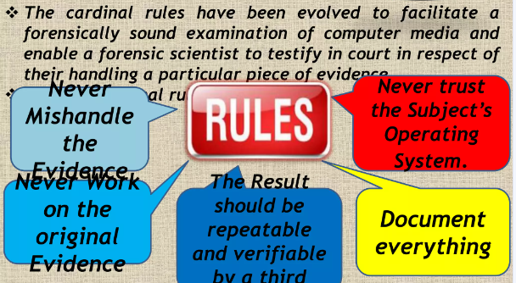
Cardinal rules of Forensics

Slide 4
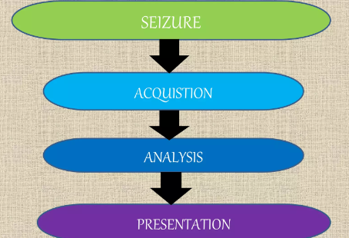
Basic concepts of analysis of digital evidences

Slide 5
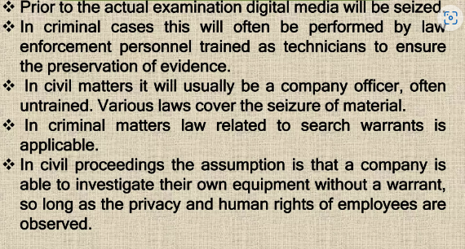
Seizures

Slide 6
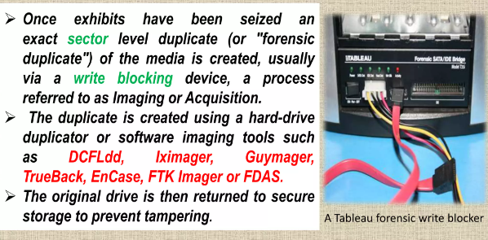
Acquisition

Slide 7
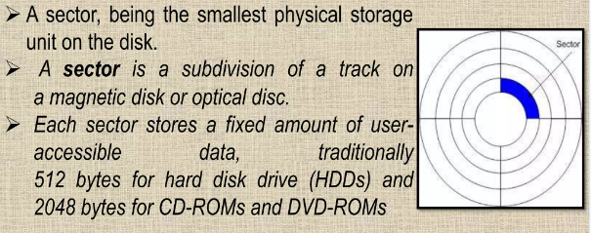
Sector

Slide 8
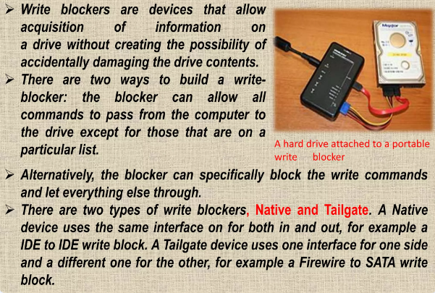
Write Blockers

Slide 9
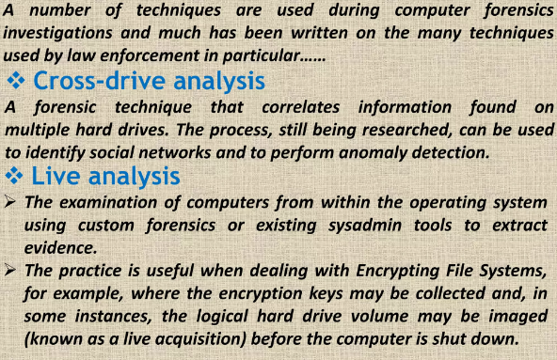
Analysis

Slide 10
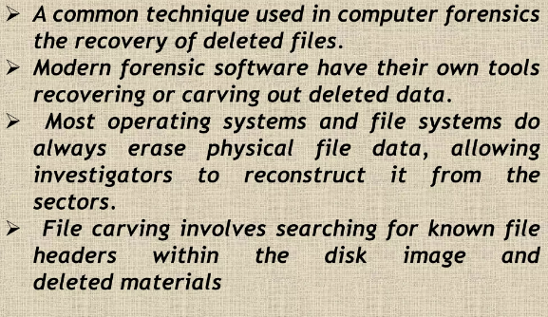
Deleted Files

Slide 11
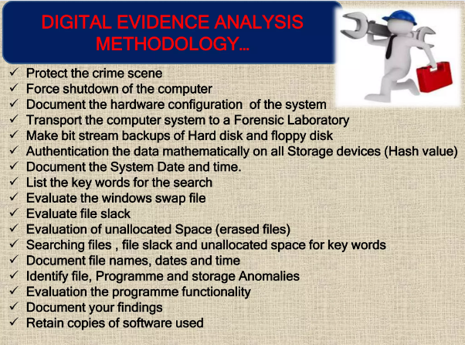
Digital Evidence Methodology

Slide 12
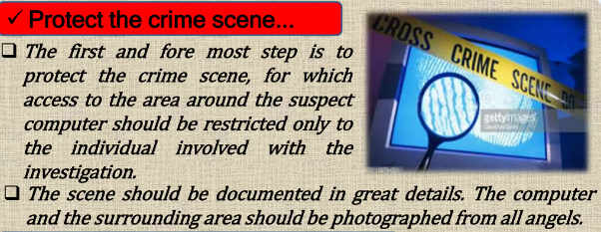
Protect the crime scene

Slide 13
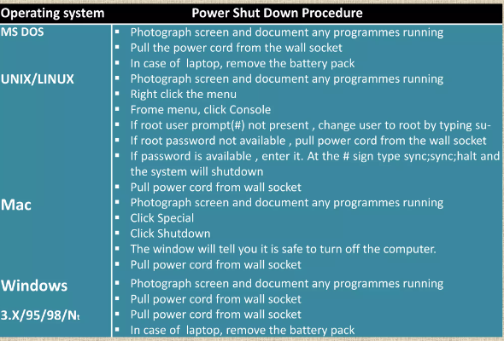
Shutdown procedure

Slide 14
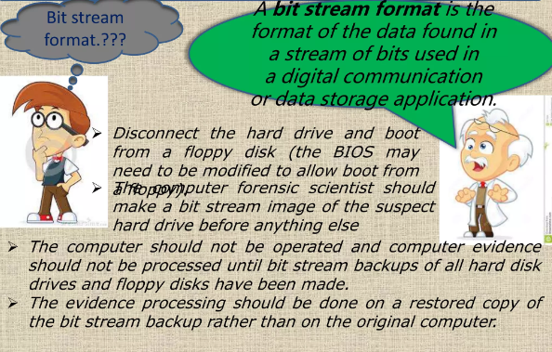
Bit Stream

Slide 15
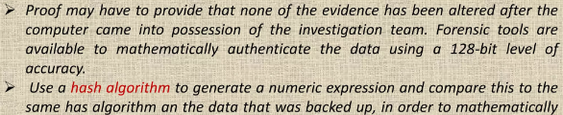
Mathematically authenticate the data on storage

Slide 16
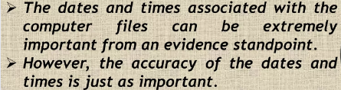
Document the system date and time

Slide 17
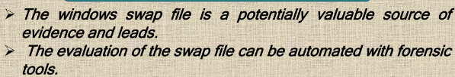
Windows swap file

Slide 18
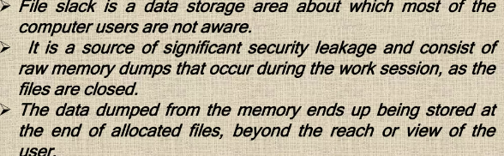
File Slack

Slide 19
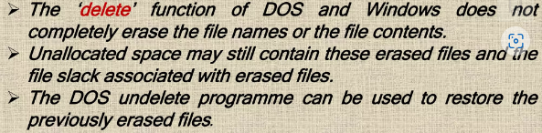
Evaluation of unallocated space

Slide 20
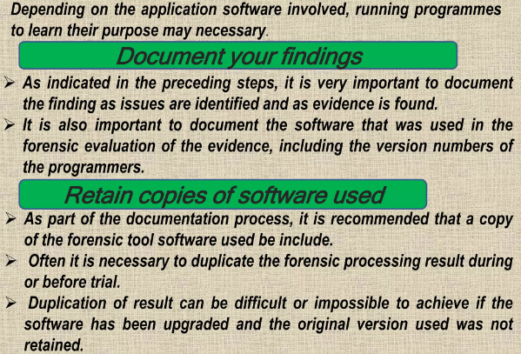
Evaluation of program functionality

Slide 21
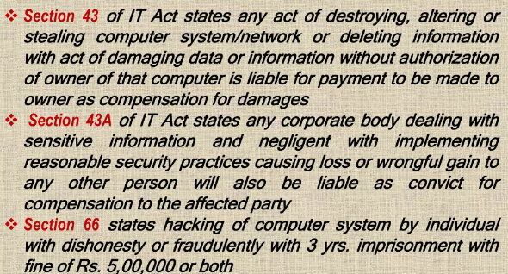
Punishment

Slide 22
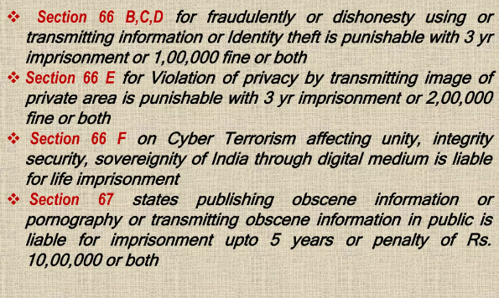
Punishment

Slide 23
Case 3: United States v. Grant, 2000
In an investigation into the notorious online Wonderland Club, Grant
argued that all evidence found in his home should be suppressed because investigators had failed to prove that he was the person associated with the illegal online activities in question.
However, the prosecution presented enough corroborating evidence to prove their case.

